Slide 1


SAPTHAGIRI COLLEGE OF ENGINEERING
(Affiliated to Visvesvaraya Technological University, Belagavi & Approved by AICTE, New Delhi)
Department of Computer Science & Engineering
Internship presentation
On
TWITTER SENTIMENTAL ANALYSIS USING NLP AND ML MODELS
Presented By:
Shravan L (1SG20CS100)
Under the Guidance of :
Prof . Hemalatha K
Assistant Professsor
Dept. of CSE.,SCE

Slide 2
CONTENTS
1. Abstract
2. Introduction about the company
3. Internship Domain
4. Project Introduction
5. Methodology
6. Results
7. Conclusion
8. References

Slide 3
ABSTRACT
Twitter provides a rich source of user-generated data, including opinions and sentiments. Analyzing sentiment in tweets can offer valuable insights but manual analysis is impractical. This project aims to develop an automated system for classifying tweet sentiment as positive or negative.
The system employs natural language processing techniques for text preprocessing and feature engineering. Machine learning models like logistic regression , multinomial NB and random forest.

Slide 4
Internship Domain
NLP:
Natural Language Processing (NLP) is a field of artificial intelligence (AI) that focuses on the interaction between computers and human language.
It involves the development of algorithms and models to enable machines to understand, interpret, and generate human-like language.
NLP applications include language translation, sentiment analysis, chatbots, and text summarization.
Key components of NLP include:
Tokenization: Breaking down text into individual words or units, known as tokens, to facilitate analysis.
Named Entity Recognition (NER): Identifying and classifying entities (such as names, locations, and dates) within text
Part-of-Speech Tagging (POS): Assigning grammatical tags to words, indicating their syntactic roles in a sentence.
Sentiment Analysis: Determining the sentiment or emotional tone expressed in a piece of text.

Slide 5
Project Introduction
The rapid growth of social media platforms like Twitter, there is an abundance of user-generated content in the form of tweets, posts, and comments. Analyzing the sentiment expressed in this data can provide valuable insights into public opinion, brand perception, customer satisfaction, and various other areas of interest.
The primary objective of this project is to develop an automated system capable of accurately classifying the sentiment expressed in tweets as positive or negative.
The system utilizes natural language processing (NLP) techniques, machine learning algorithms, and text classification models to process and analyze the textual content of tweets.

Slide 6
Methodology
1. Data Collection
2. Data Preprocessing
3. Exploratory Data Analysis (EDA)
4. Model Selection and Training
5. Performance Evaluation

Slide 7
DATASET OVERVIEW
The dataset used in this project was obtained from a reputable source (e.g., Kaggle, academic repositories, or web scraping). It consists of a total of [31962] tweets, providing a substantial amount of data for training and evaluating the sentiment analysis models.
The dataset is structured as a table or a CSV file, with each row representing a single tweet. The key attributes present in the dataset are:
  id: A unique identifier for each tweet.
  tweet: The textual content of the tweet.
  label: The sentiment label associated with the tweet, typically binary (0 for positive sentiment, 1 for negative sentiment).

Slide 8
Data Collection
Obtain a dataset of tweets with sentiment labels (positive, negative) from sources like Kaggle, academic repositories, or web scraping.
Ensure the dataset is representative of the domain and has sufficient samples for both sentiment classes.
2. Data Preprocessing
Clean the tweet text by removing URLs, usernames, hashtags, and irrelevant content.
Handle noise like misspellings, slang, and abbreviations using techniques like regex substitution or lookups.
Tokenize the text into individual words,removing stop words and stemming.

Slide 9
3. Exploratory Data Analysis (EDA)
Analyze the distribution of sentiment labels in the dataset.
Investigate potential class imbalance and handle it appropriately .
Visualize word frequencies, word clouds, and other characteristics of the text data.
Identify and address any data quality issues or outliers.
4. Model Selection and Training
Select appropriate machine learning algorithms for sentiment classification, such as:
  Naive Bayes
  Logistic Regression
  Random Forest
Train the selected models on the training data using the feature vectors and sentiment labels.

Slide 10
5. Performance Evaluation
Evaluate the trained models on the test set using appropriate metrics like:
  Accuracy
  F1-score
Analyze misclassified instances and potential sources of error.
Compare the performance of different models and select the best-performing one(s).

Slide 11
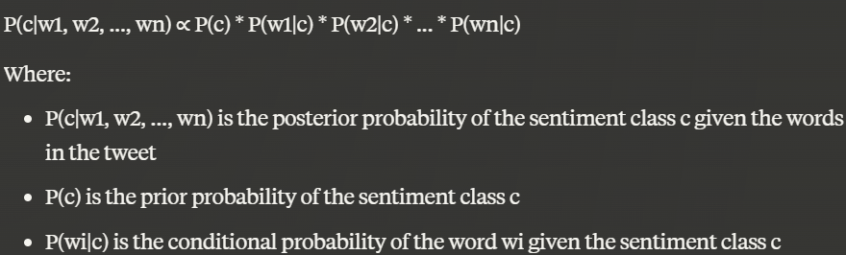
ALGORITHMS
1. MultiNomial Naïve Bayes Classifier:
    FORMULAS:

Slide 12
CODE:
from sklearn.naive_bayes import MultinomialNB
nb_model = MultinomialNB()
nb_model.fit(x_train, y_train)
nb_pred = nb_model.predict(x_test)
nb_f1_score = f1_score(y_test, nb_pred)
nb_accuracy = accuracy_score(y_test, nb_pred)
print("Multinomial Naive Bayes Model Evaluation:")
print("F1 Score:", nb_f1_score)
print("Accuracy Score:", nb_accuracy)

Slide 13
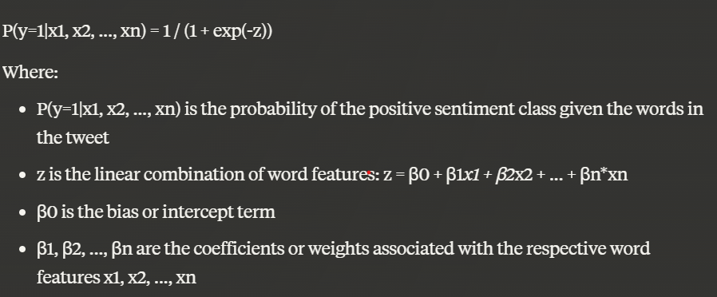
ALGORITHMS
2. Logistic Regression:
    FORMULAS:

Slide 14
CODE:
from sklearn.linear_model import LogisticRegression
from sklearn.metrics import f1_score, accuracy_score
model = LogisticRegression()
model.fit(x_train, y_train)
pred = model.predict(x_test)
f_score=f1_score(y_test, pred)
a_score=accuracy_score(y_test,pred)
print("Logistic regression Model Evaluation:")
print("F1 Score:",f_score )
print("Accuracy Score:",a_score)

Slide 15
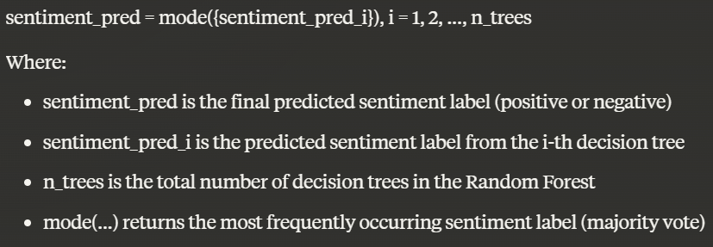
ALGORITHMS
3. Random forest:
    FORMULAS:

Slide 16
CODE:
from sklearn.ensemble import RandomForestClassifier
rf_model = RandomForestClassifier(n_estimators=100, random_state=42)
rf_model.fit(x_train, y_train)
rf_pred = rf_model.predict(x_test)
rf_f1_score = f1_score(y_test, rf_pred)
rf_accuracy = accuracy_score(y_test, rf_pred)
print("\nRandom Forest Model Evaluation:")
print("F1 Score:", rf_f1_score)
print("Accuracy Score:", rf_accuracy)

Slide 17
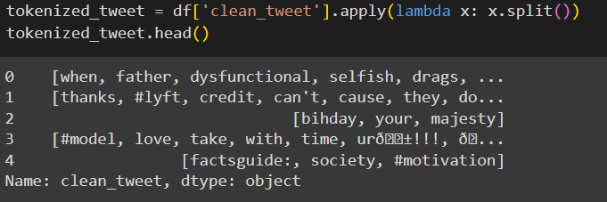
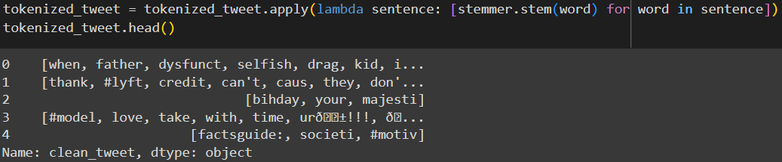
Result
Tokenization And Stemming Of Tweets

Slide 18
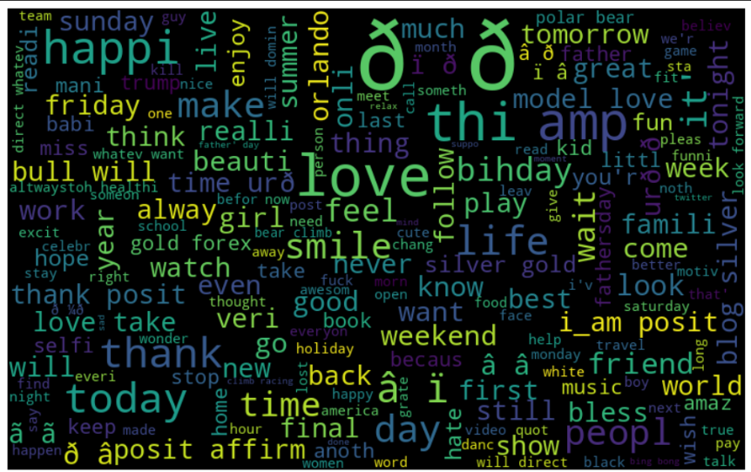
Positive Word Cloud

Slide 19
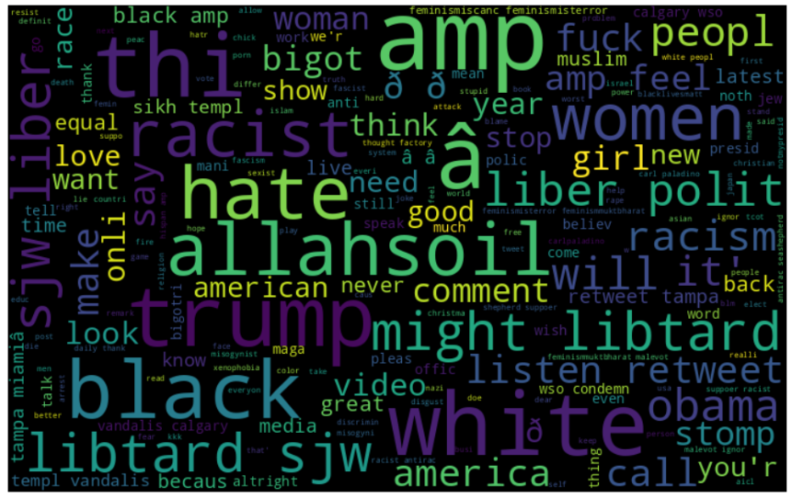
Negative Word Cloud

Slide 20
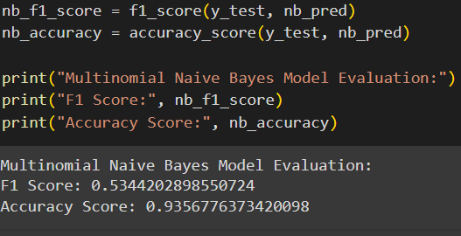
Naïve Bayes Model Evaluation

Slide 21
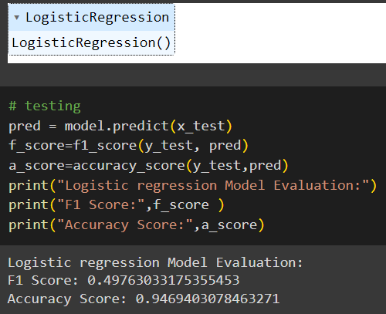
Logistic Regression Model Evaluation

Slide 22
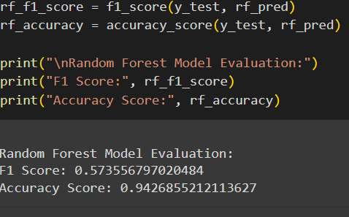
Random Forest Model Evaluation

Slide 23
model | Accuracy score | F1-score
Logistic Regression | 0.9433112251282693 | 0.5545722713864307
Naïve bayes | 0.9356776373420098 | 0.5344202898550724
Random Forest | 0.9426855212113627 | 0.573556797020484
Performance evaluation

Slide 24
Performance evaluation using Pie chart

Slide 25
CONCLUSION
The Twitter Sentiment Analysis project successfully developed an automated system for classifying the sentiment expressed in tweets as positive or negative.
The system employed natural language processing techniques, machine learning algorithms, and text classification models to process and analyze the textual content of tweets.
FUTURE ENHANCEMENT:
Extending the current binary (positive/negative) sentiment classification model to a multi-class model that can classify tweets into more granular sentiment categories like positive, negative, neutral, and potentially even detect specific emotions like happiness, anger, sadness, etc. This would provide more nuanced insights into the sentiment landscape.

Slide 26
REFERENCES
[1] https://www.geeksforgeeks.org/project-idea-ai-therapist/amp/
[2] https://youtu.be/4YGkfAd2iXM?si=1vbSSHpUhFD003s-
[3] https://youtu.be/RLfUyn3HoaE?si=zqiB7qFGn-kR_77f
[4] Medhat, W., Hassan, A., & Korashy, H. (2014). Sentiment analysis algorithms and applications: A survey. Ain Shams Engineering Journal, 5(4), 1093-1113.
[5] Liu, B. (2012). Sentiment analysis and opinion mining. Synthesis lectures on human language technologies, 5(1), 1-167.

Slide 27
THANK
YOU

